Slide 1
Java
I/O
Md. Shafqat Talukder Rakin
Lecturer, Department of CSE,
United International University
Email id : shafqat@cse.uiu.ac.bd
Acknowledged: Rifat Shahriyar Sir

Slide 2
File
Long‐term storage of large amounts of data
Persistent data exists after termination of program
Files stored on secondary storage devices
Magnetic disks
Optical disks
Magnetic tapes
Sequential and random access files

Slide 3
File Class
Provides useful information about a file or directory
Does not open files or process files
To obtain or manipulate path, time, date, permissions etc
Constructor
File(String directoryPath)
File(String directoryPath, String fileName)
File(File dirObj, String fileName)
Example: FileDemo.java

Slide 4
Directory
Directories are also files
Contains list of files and directories
For Directory isDirectory() returns true
String[] list()
returns an array of strings that gives the files and directories contained
File[] listFiles()
Returns array of File objects
Example: DirectoryDemo.java

Slide 5
Stream Classes
Java views a File as a stream of bytes.
File ends with end‐of‐file marker or a specific byte number
File as a stream of bytes associated with an object.
Java also associates streams with devices
System.in, System.out, and System.err
Streams can be redirected
Stream is an abstraction that either produces or consumes information

Slide 6
Stream Classes
Java’s stream‐based I/O is built upon four abstract
classes.
InputStream, OutputStream (for byte streams)
Reader, Writer (for character streams)
They form separate hierarchies
Use the character stream classes when working with characters or strings
Use the byte stream classes when working with bytes or other binary objects

Slide 7
Byte Stream Classes
Topped by InputStream and OutputStream classes
InputStream is an abstract class that defines Java’s
model of streaming byte input.
int available() void close() int read()
int read(byte buff[]) int read(byte buff[], int off, int num)
OutputStream is an abstract class that defines Java’s
model of streaming byte output.
void flush() void close() void write(int b)
void write(byte buff[]) void write(byte buff[], int off, int num)

Slide 8
FileInputStream
FileInputStream class creates an InputStream that you can use to read bytes from a file
Constructors
FileInputStream(String filePath)
FileInputStream(File fileObj)
Example: FileInputStreamDemo.java

Slide 9
FileOutputStream
FileOutputStream class creates an OutputStream
that you can use to write bytes to a file
Constructors
FileOutputStream(String filePath)
FileOutputStream(File fileObj)
FileOutputStream(String path, boolean append)
FileOutputStream(File obj, boolean append)
Example: FileOutputStreamDemo.java, FileCopyDemo.java

Slide 10
Character Stream Classes
Topped by Reader and Writer classes
Reader is an abstract class that defines Java’s model
of streaming character input
void close() int read() int read(char buff[]) int read(char buff[], int off, int num)
Writer is an abstract class that defines Java’s model
of streaming character output
void flush() void close() void write(int ch)
void write(char buff[]) void write(char buff[], int off, int num) void write(String s) void write(String s, int off, int num)

Slide 11
FileReader
FileReader class creates a Reader that you can use to read the contents of a file
Constructors
FileReader(String filePath)
FileReader(File fileObj)
Example: FileReaderDemo.java

Slide 12
FileWriter
FileWriter class creates a Writer that you can use to write to a file
Constructors
FileWriter(String filePath)
FileWriter(File fileObj)
FileWriter(String path, boolean append)
FileWriter(File obj, boolean append)
Example: FileWriterDemo.java

Slide 13
BufferedReader
BufferedReader is a Reader that buffers input
It improves performance by reducing the number of times data us actually physically read from the input stream
Constructors
BufferedReader(Reader reader)
BufferedReader(Reader reader, int buffSize)
Example: BufferedReaderDemo.java

Slide 14
BufferedWriter
BufferedWriter is a Writer that buffers output
It improves performance by reducing the number of times data actually physically written to the output stream
Constructors
BufferedWriter(Writer writer)
BufferedWriter(Writer writer, int buffSize)
Example: BufferedWriterDemo.java

Slide 15
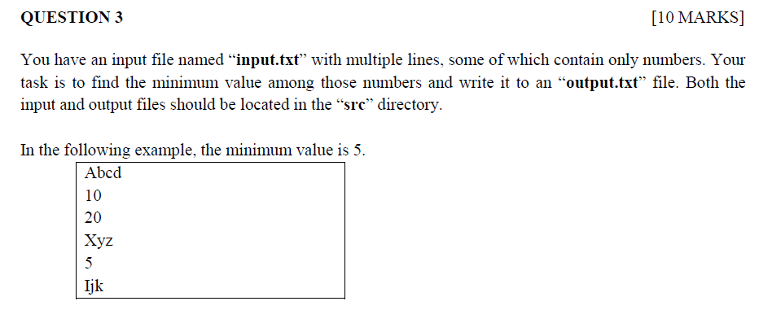
Spring 2024 Question 3

Slide 16
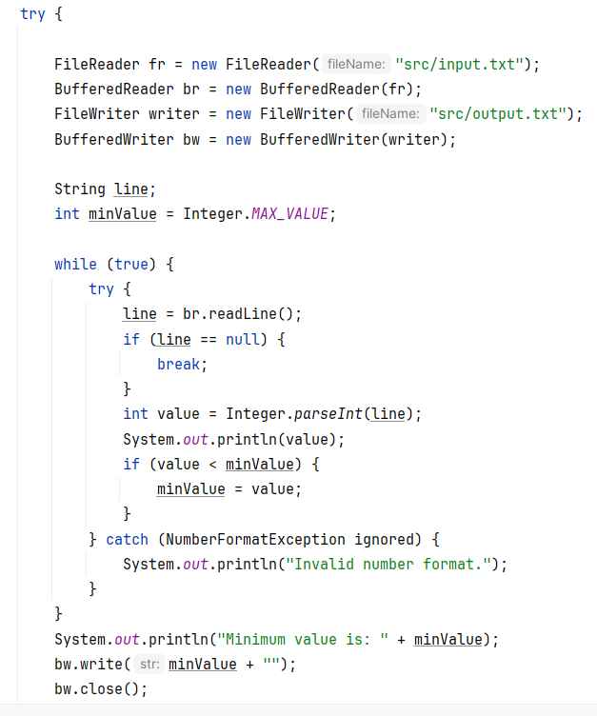
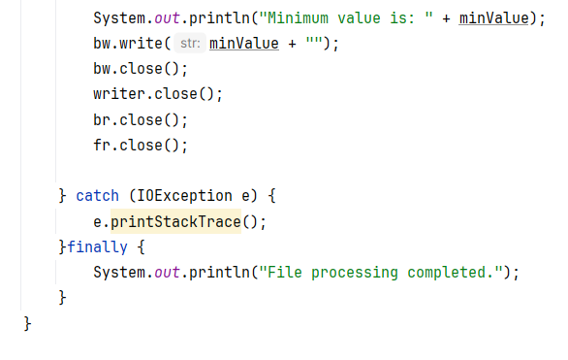
Spring 2024 Question 3

Slide 17
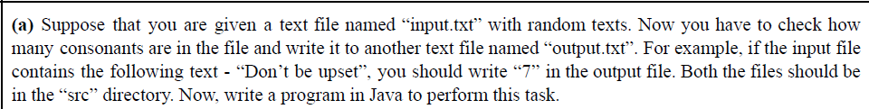
Fall 2023 Question 2(a)

Slide 18
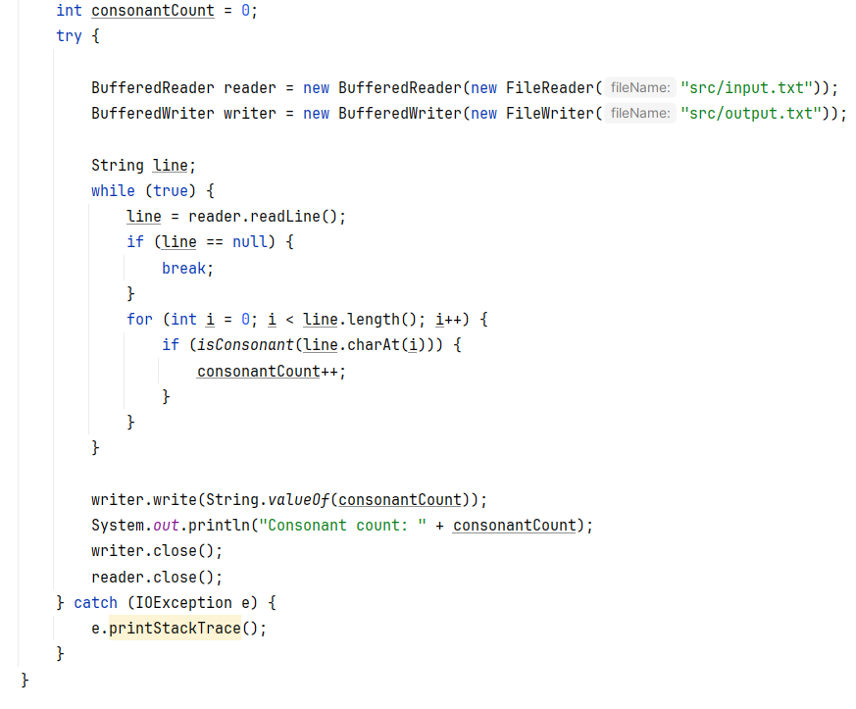
Fall 2023 Question 2(a)

Slide 19
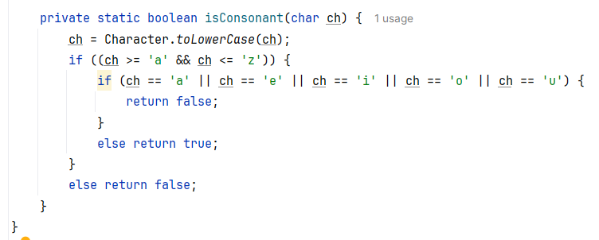
Fall 2023 Question 2(a)

Slide 20
Thank You

